Slide 1

Web scraping and analysis

Slide 2
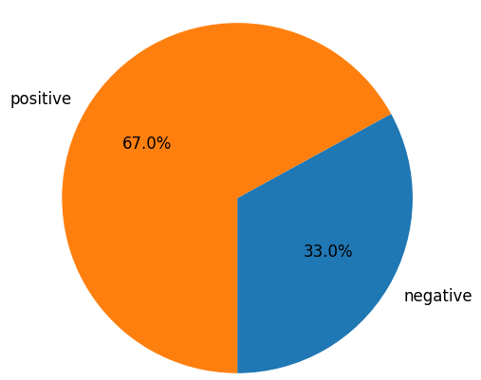
From cleaning 3590 reviews given by the customers, we obtained
Positive Reviews - 2406
Negative Reviews - 1184

Slide 3
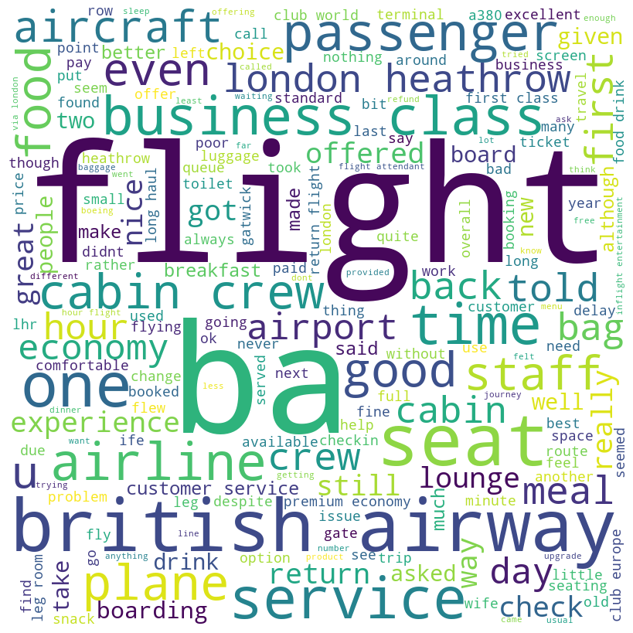
Word cloud of keywords used in reviews

Slide 4
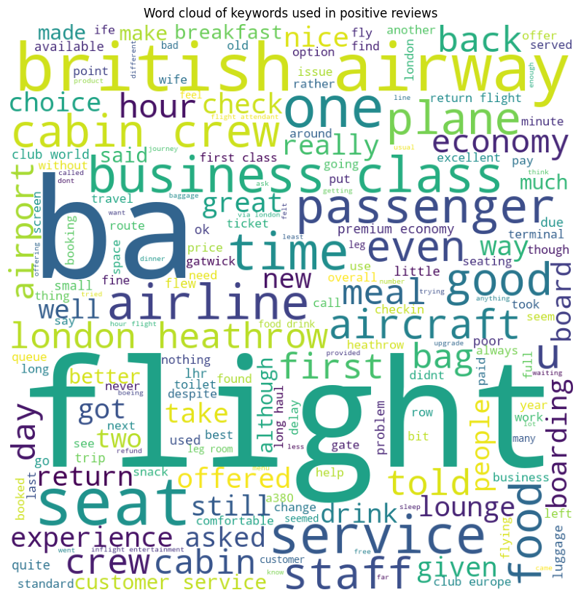
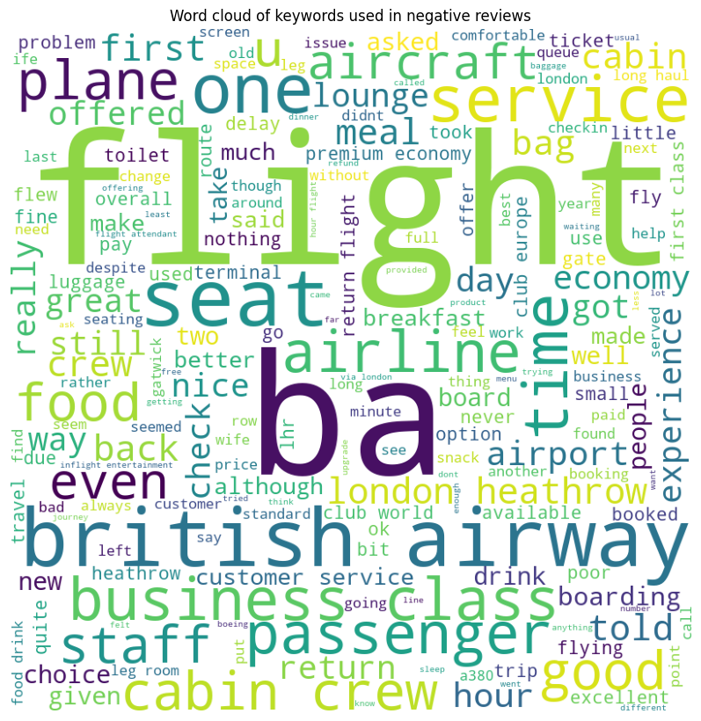
Word cloud of keywords used in pos and neg reviews

